Slide 1

Portfolio realization for modern enterprises

Slide 2





Modern enterprises need to
Delight with experience
Deliver faster
Every business is technology
Possess skilled talent
Continuously innovate

Slide 3



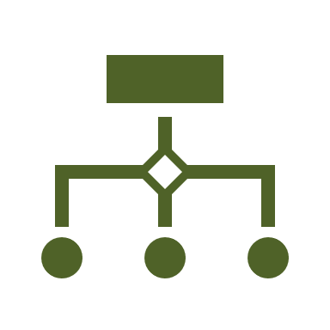




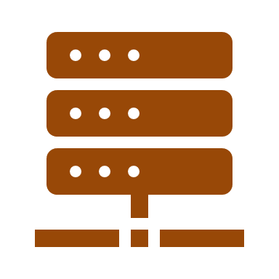

What is the right mindset to adopt in realization of the portfolios?
Project Mindset
Development
Operations
Product Mindset
Platforms
Platform Mindset
Consumers
Platforms
Providers
Business
Technology
Individual projects by respective owners, with complex program management to bring in synergies Multiple layers and service towers in operations, with SIAM bringing in the integration Huge separation wall between development and operations, with traditional operations | Consumer focused products with a single owner for the experience of the consumer with the product Team of engineers, designers, business analyst, led by business-oriented leader Agile ways of working across business and technology | Platform capabilities created with considerations on providers and consumers Configurable and interoperable platform capabilities to new business capabilities Additional business can be created with the network effect.

Slide 4




Building systems to support real-time business, in product centric way
Traditional enterprise
Digital native enterprise
Product Design & Engineering | Consumer facing services | Data, analytics and insights
 | Backend business services
Products
Distinct business owner for each part of the business process value chain
Data movement across is slow and not effectively used to drive business efficiency and tap opportunities
Owner of the customer services, do not control the complete value chain to manage the customer experience.
Single product owner responsible for the value chain
Data movement is real-time to fulfill client needs in shortest time and enable real-time decision making in improving customer experience and business efficiency
Agile implementation of capabilities to respond to market needs faster

Slide 5






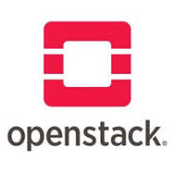

















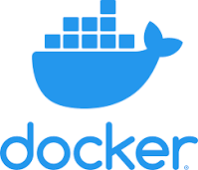



















Roles in the digital native organization
Digital Factory
Platform Engineering
Site reliability engineering
Application runtimes
Database, Analytics, AI&ML
Realtime processing
Security
Cloud provider
Container platforms
Orchestration
DevOps
Observability

